Slide 1
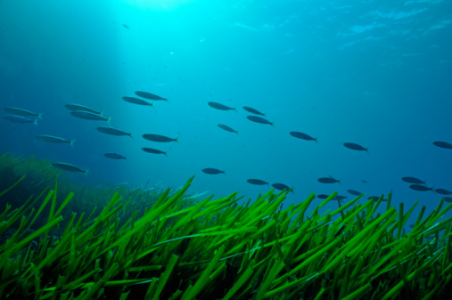
Oceans Day at COP21 04 December 2015 – UNFCCC COP21 Paris, France Dorothée Herr, GMPP, IUCN
Panel 3. Mitigation and the Oceans
Setting the Stage: Issues and Prospects for Mitigation Efforts

Slide 2
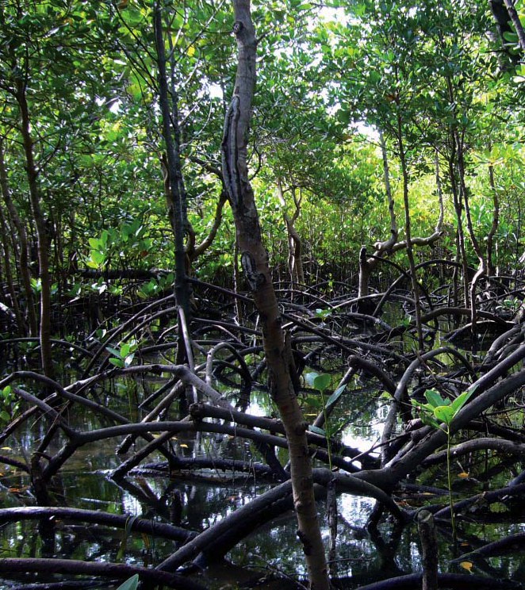
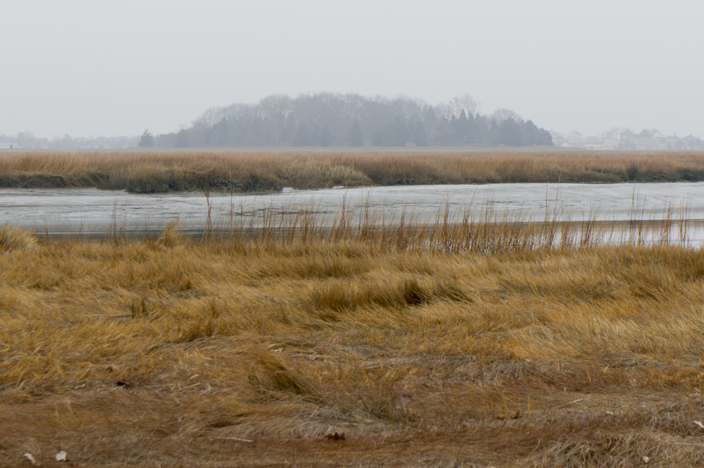
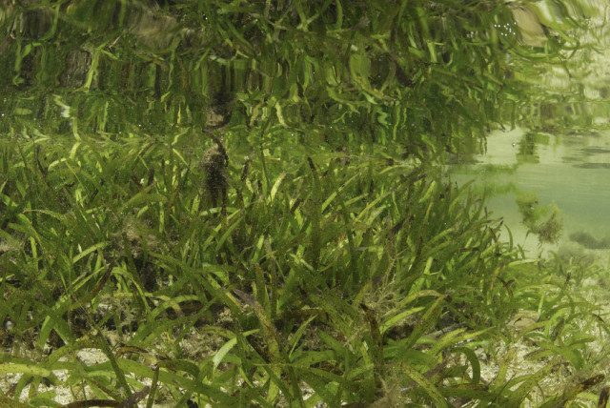
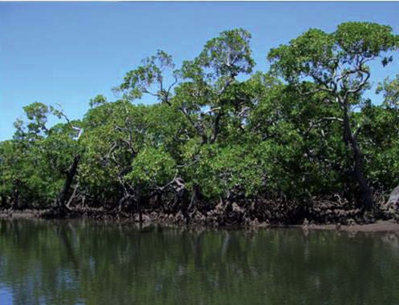
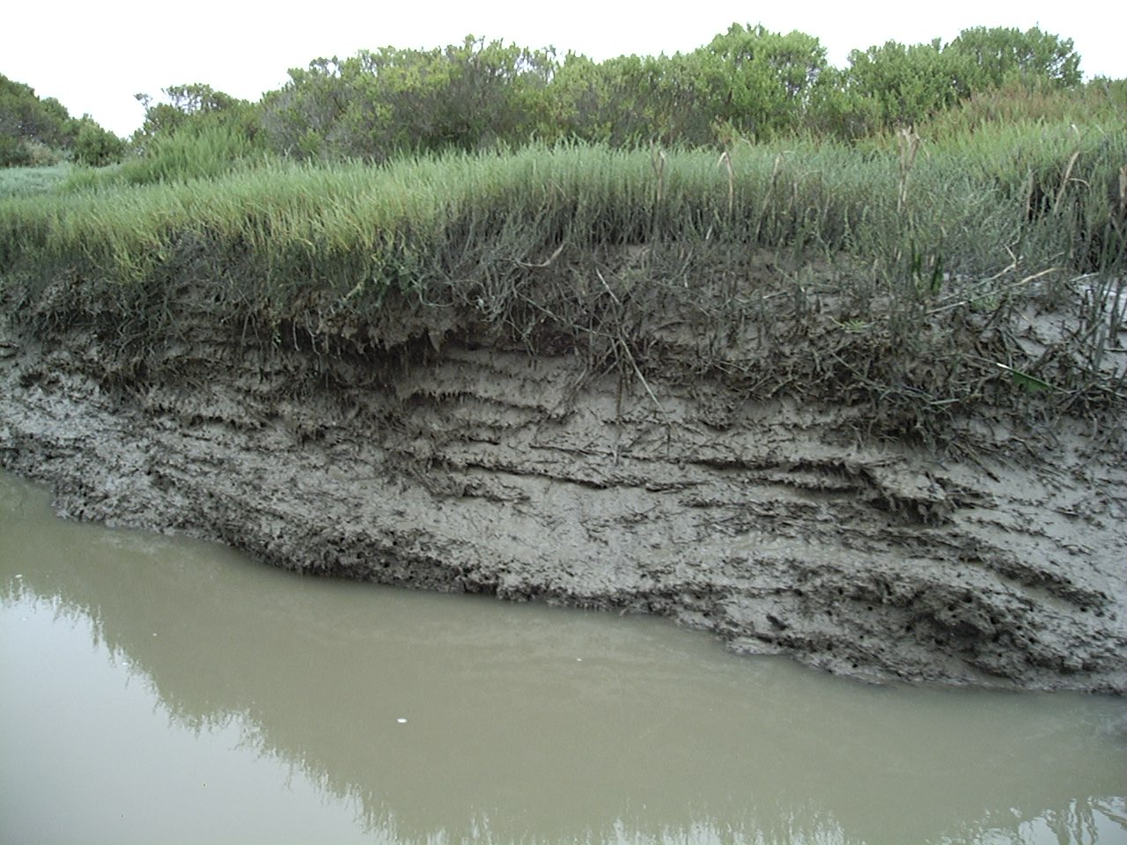
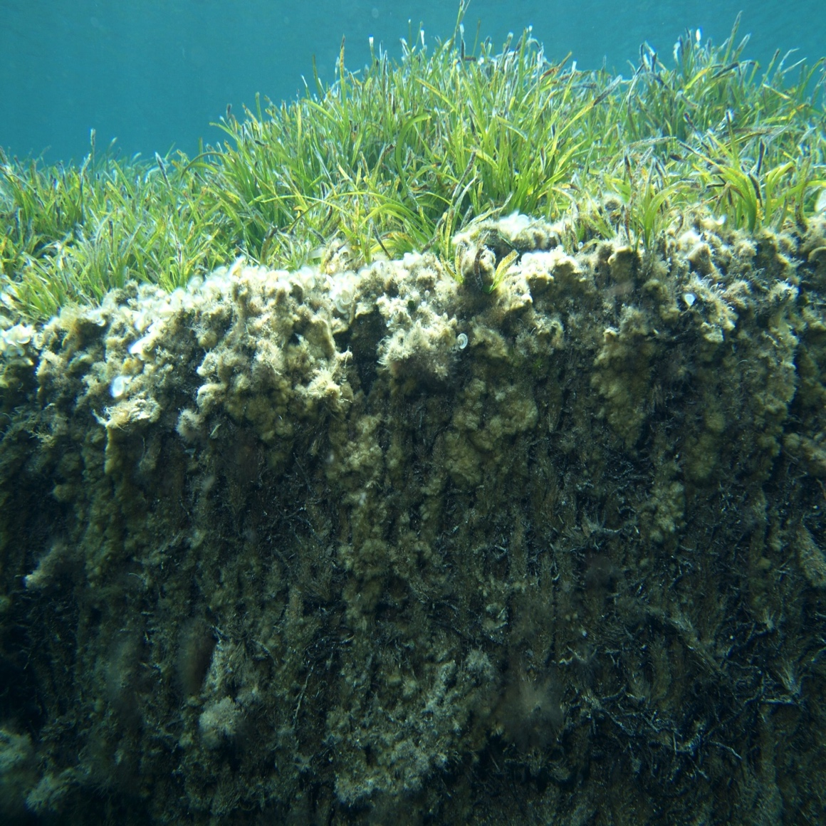
NAMAs
IPCC 2013 Wetlands Supplement
REDD+
INDCs
National GHG inventories
1. Coastal (blue) carbon wetlands
Other policies
National / International
Carbon offset projects
Photos clockwise from top left: © Steve Crooks, © CI/photo by Sarah Hoyt, © M.A. Mateo, © Keith Ellenbogen, © Jeff Yonover, © CI/photo by Sarah Hoyt

Slide 3
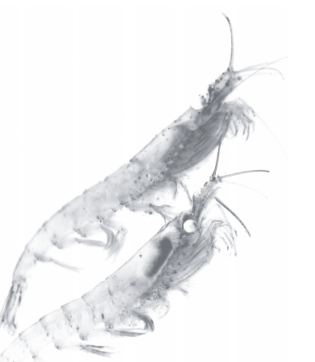
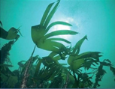
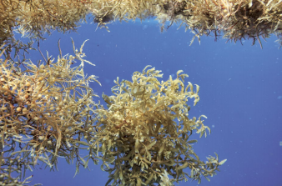
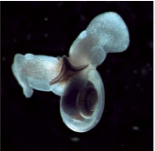
2. Ocean (Blue) Carbon
And The UNFCCC?
And other MEAs
Laffoley, D., Baxter, J. M., Thevenon, F. and Oliver, J. (editors). 2014. The Significance and Management of Natural Carbon Stores in the Open Ocean. Full report. Gland, Switzerland: IUCN. 124 pp
Notes:
Marine ecosystems and species, incl. in the open ocean or deep sea (i.e., corals, kelp, plankton and marine fauna)
Important role in the carbon cycle – only a healthy ocean can maintain its climate services
?? Long-term storage
?? National carbon balances
As part of the UNFCCC / incentive mechanism??
We need a thoughtful debate

Slide 4
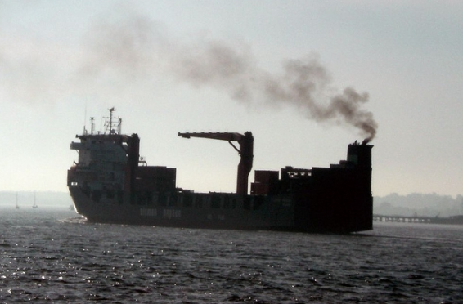
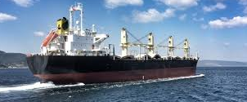
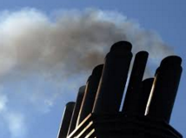
3. Emissions from Ships
Maritime transport emits around 1.000 million tonnes of CO₂ annually and is responsible for about 2.5% of global GHG emissions (3rdIMO GHG study).
Shipping emissions are predicted to increase between 50% and 250% by 2050 – depending on future economic and energy developments.
Ship Energy Efficiency Management Plan (SEEMP)
Energy Efficiency Design Index (EEDI)
Integrated Technical Co-operation Programme (ITCP)
New ideas on technical and operational measures
Global system for data collection or monitoring, reporting and verification (MRV)
http://ec.europa.eu/clima/policies/transport/shipping/index_en.htm

Slide 5
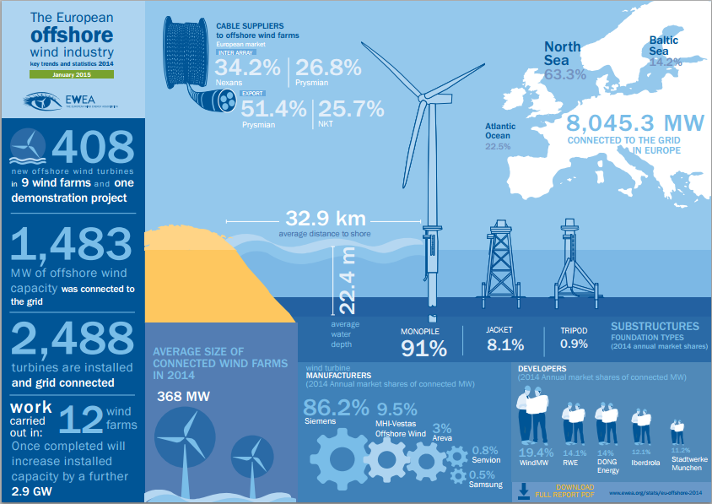
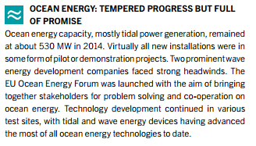
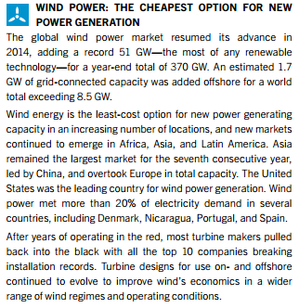
4. Renewable engery from the Ocean
Environmental
Impact
Assessment
Marine
Spatial
Planning

Slide 6
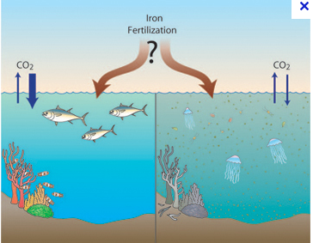
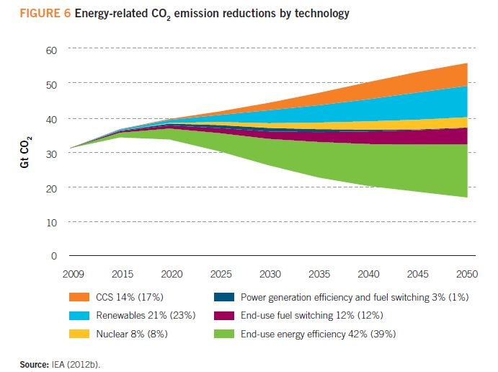
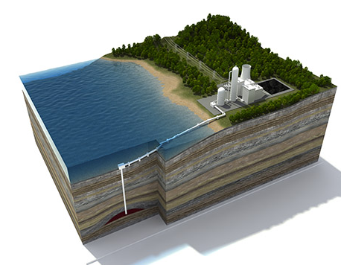
5. Ocean-based Sequestration and Marine Geoengineering
Carbon capture and storage
- CO₂ released directly into seawater
- Ocean fertilization
- Geological formation
Carbon Capture and Storage
Energy saving
Carbon Capture and Storage

